Slide 1
Information Processing Techniques
Week 07
Abeeha Sattar

Slide 2
Azure Functions

Slide 3
Infrastructure as a Service (IaaS)
It provides only a base infrastructure (Virtual machine, Software Define Network, Storage attached). End user have to configure and manage platform and environment, deploy applications on it.
AWS (EC2), GCP (CE), Microsoft Azure (VM) are examples of IaaS.

Slide 4
Software as a Service (SaaS)
It is sometimes called to as “on-demand software”. Typically accessed by users using a thin client via a web browser. In SaaS everything can be managed by vendors: applications, runtime, data, middleware, OSes, virtualization, servers, storage and networking, End users have to use it.
GMAIL is Best example of SaaS. Google team managing everything just we have to use the application through any of client or in browsers. Other examples SAP, Salesforce .

Slide 5
Platform as a Service (PaaS)
It provides a platform allowing end user to develop, run, and manage applications without the complexity of building and maintaining the infrastructure.
Google App Engine, CloudFoundry, Heroku, AWS (Beanstalk) are some examples of PaaS.

Slide 6
Container as a Service (CaaS)
Is a form of container-based virtualization in which container engines, orchestration and the underlying compute resources are delivered to users as a service from a cloud provider.
Google Container Engine(GKE), AWS (ECS) and Azure (ACS) are some examples of CaaS.

Slide 7
Function as a Service (FaaS):
It provides a platform allowing customers to develop, run, and manage application functionalities without the complexity of building and maintaining the infrastructure.
AWS (Lamda), Google Cloud Function, Azure Functions are some examples of FaaS

Slide 8
Azure Functions
Azure Functions is a serverless solution that allows you to write less code, maintain less infrastructure, and save on costs. Instead of worrying about deploying and maintaining servers, the cloud infrastructure provides all the up-to-date resources needed to keep your applications running.
You focus on the pieces of code that matter most to you, and Azure Functions handles the rest.

Slide 9









Azure Functions
Events
Code
Outputs
React to timers, HTTP, or events from your favorite Azure services, with more on the way
Author functions in C#, F#, Node.JS, Java, and more
Send results to an ever-growing collection of services
Notes:
Originally presented at Ignite 2018 by:
Fabio Cavalcante
Eduardo Laureano
Source: https://myignite.techcommunity.microsoft.com/sessions/65889

Slide 10
Azure Functions can be used…
If you want to... | then...
Build a web API | Implement an endpoint for your web applications using the HTTP trigger
Process file uploads | Run code when a file is uploaded or changed in blob storage
Build a serverless workflow | Chain a series of functions together using durable functions
Respond to database changes | Run custom logic when a document is created or updated in Cosmos DB
Run scheduled tasks | Execute code at set times
Create reliable message queue systems | Process message queues using Queue Storage, Service Bus, or Event Hubs
Analyze IoT data streams | Collect and process data from IoT devices
Process data in real time | Use Functions and SignalR to respond to data in the moment

Slide 11
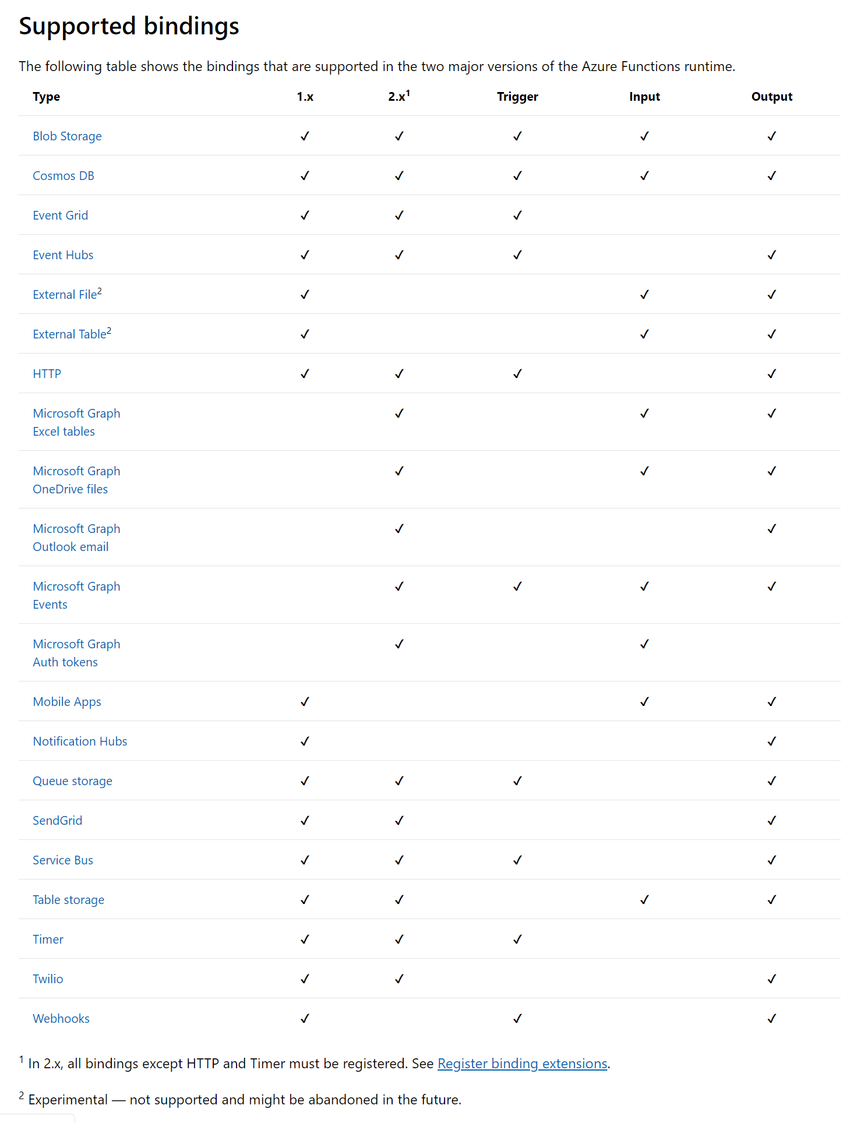

Slide 13
Azure Functions
As you build your functions, you have the following options and resources available:
Use your preferred language: Write functions in C#, Java, JavaScript, PowerShell, or Python, or use
a custom handler to use virtually any other language.
Automate deployment: From a tools-based approach to using external pipelines, there's a myriad of
deployment options available.
Troubleshoot a function: Use monitoring tools and testing strategies to gain insights into your apps.
Flexible pricing options: With the Consumption plan, you only pay while your functions are running, while
the Premium and App Service plans offer features for specialized needs.

Slide 14
Durable Functions

Slide 15
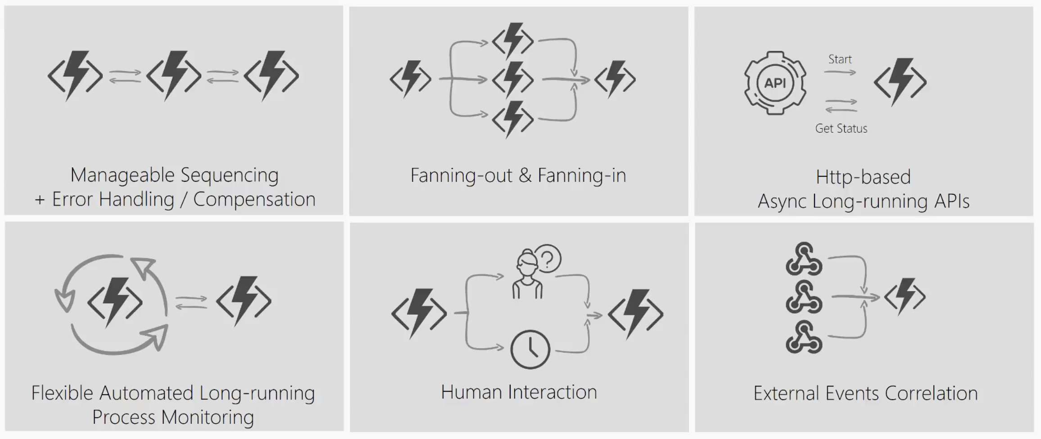
Notes:
In the function chaining pattern, a sequence of functions executes in a specific order. In this pattern, the output of one function is applied to the input of another function.
Executing multiple functions concurrently and then performing some aggregation on the results
Orchestrator functions have the ability to wait and listen for external events
Azure Functions offers built-in integration with Azure Application Insights to monitor functions
Application Insights collects log, performance, and error data
The monitor pattern refers to a flexible, recurring process in a workflow. An example is polling until specific conditions are met. You can use a regular timer trigger to address a basic scenario, such as a periodic cleanup job
Communication with APIs using HTTP
For example: Mobile Verification

Slide 16
Fin.

